Slide 1

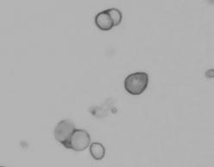
Cell preparation for 10X
Diana Burkart-Waco, PhD
dburkart@ucdavis.edu

Slide 2
Overview
Technology overview.
Single cell isolation.
Sample QC.
Do I have single cells?
Are they alive?
Are they too big?
Did I isolate the correct cells?
How do I count them?
Methanol Fixation.

Slide 3
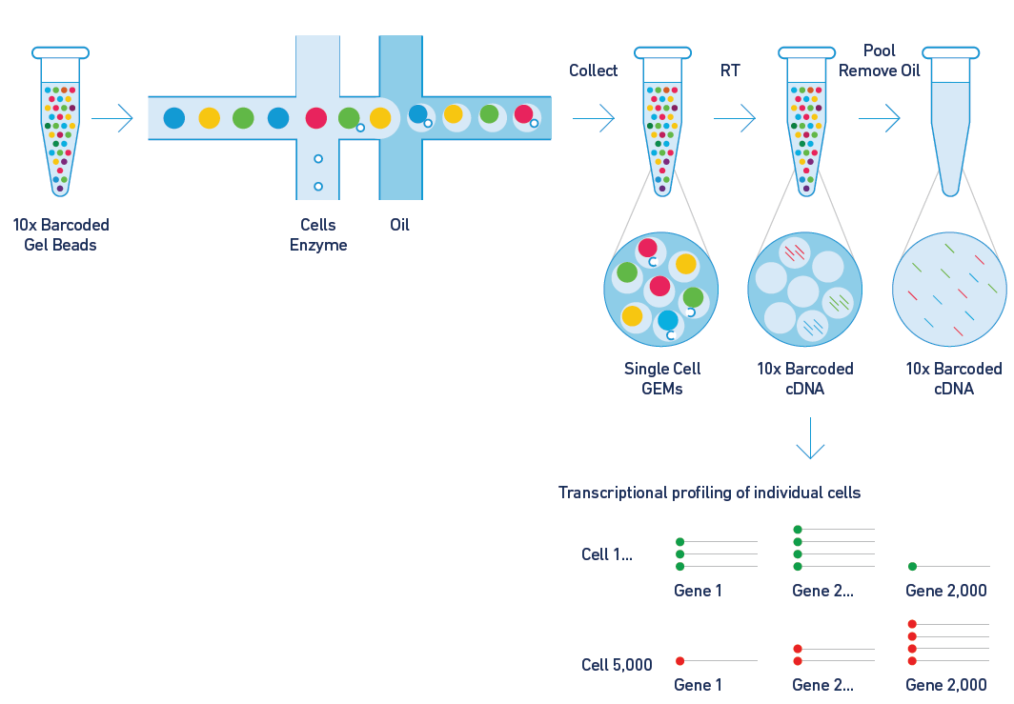
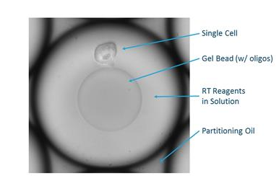
10X technology

Slide 4
Sample preparation
Single cell isolation is key.
No one protocol fits all.
Invest time sample preparation.
10xgenomics.com/

Slide 5
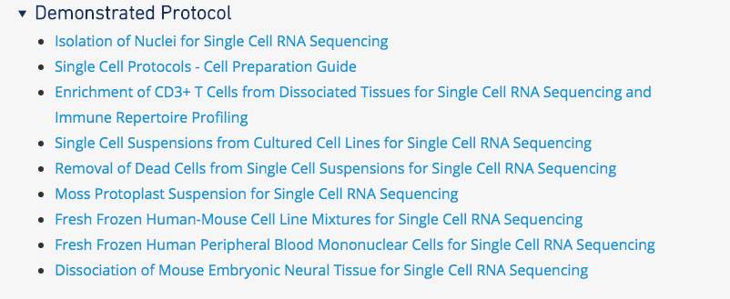
Cell isolation
Cell isolation guides available at:
https://www.support.10xgenomics.com/single-cell-gene-expression/sample-prep/
Dissociation and preparation depends on cell type.

Slide 6
Factors influencing success
Cell debris.
Aggregates.
Proper concentration estimates.
Buffer.
Storage.

Slide 7
Workflow
Single cell suspension
Visually inspect cells
Filter
NO
Free of debris
YES
Count

Slide 8
Debris
Organic matter left over from dead cells.
Impacts targeted cell recovery.
Free RNA → noise.
Hard to obtain cell counts.
Clog microfluidics
http://www.nexcelom.com/Cellometer-Vision-CBA/

Slide 9
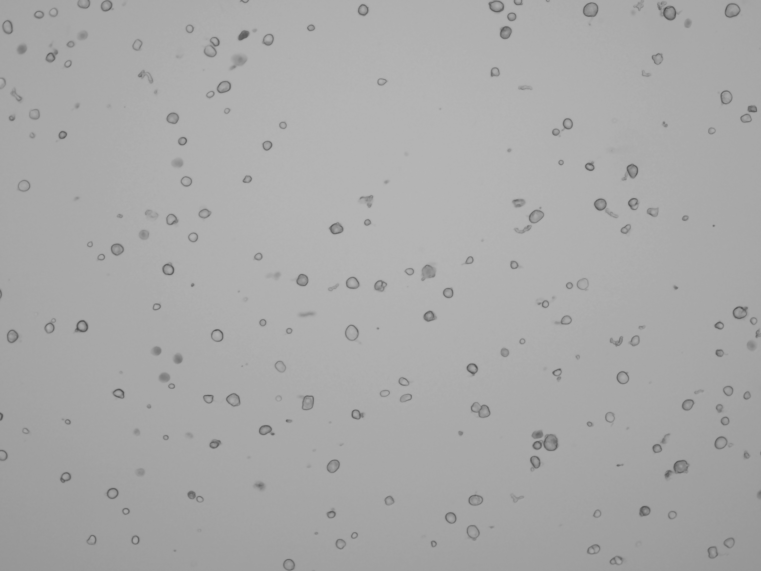
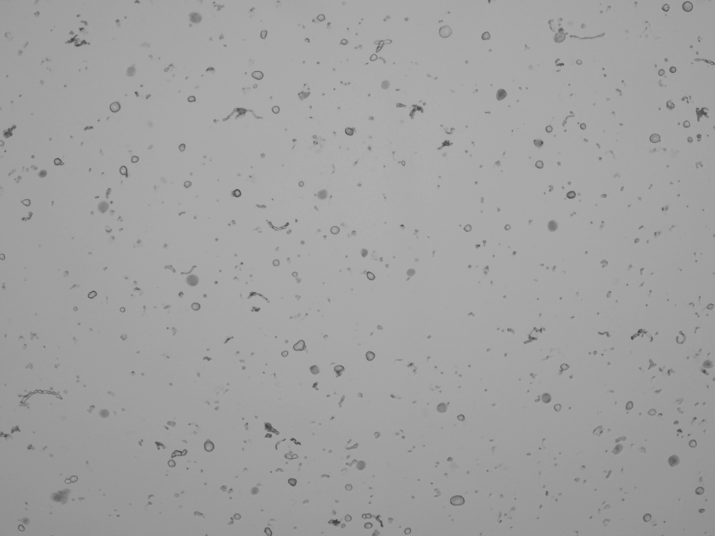
Cell debris example I
Mouse
Clean DRG sample Noisy sample
Clean DRG sample Noisy sample
Recommended treatment: filtration, centrifuge, add blocking agent.

Slide 10

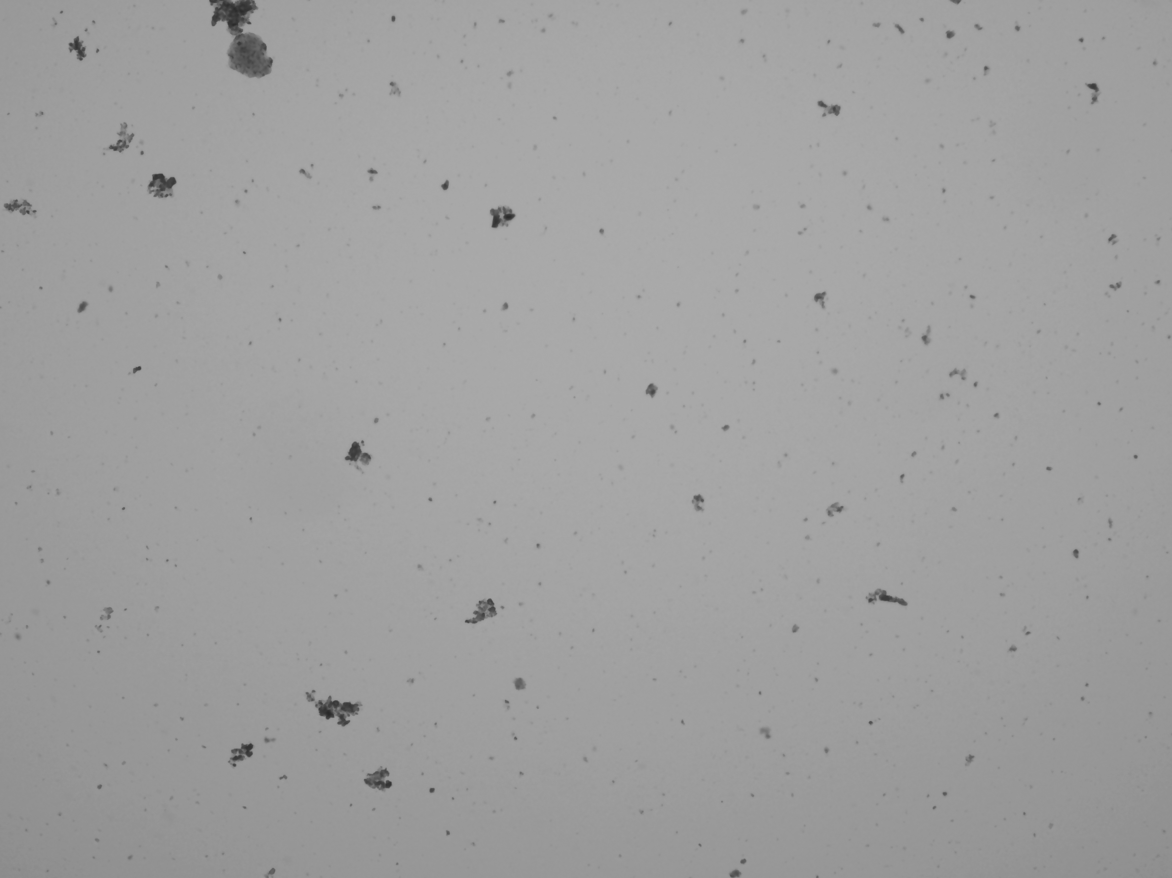
Cell debris example II
Human
Bone shard
Clean human sample All debris
Recommended treatment: redo isolation.

Slide 11

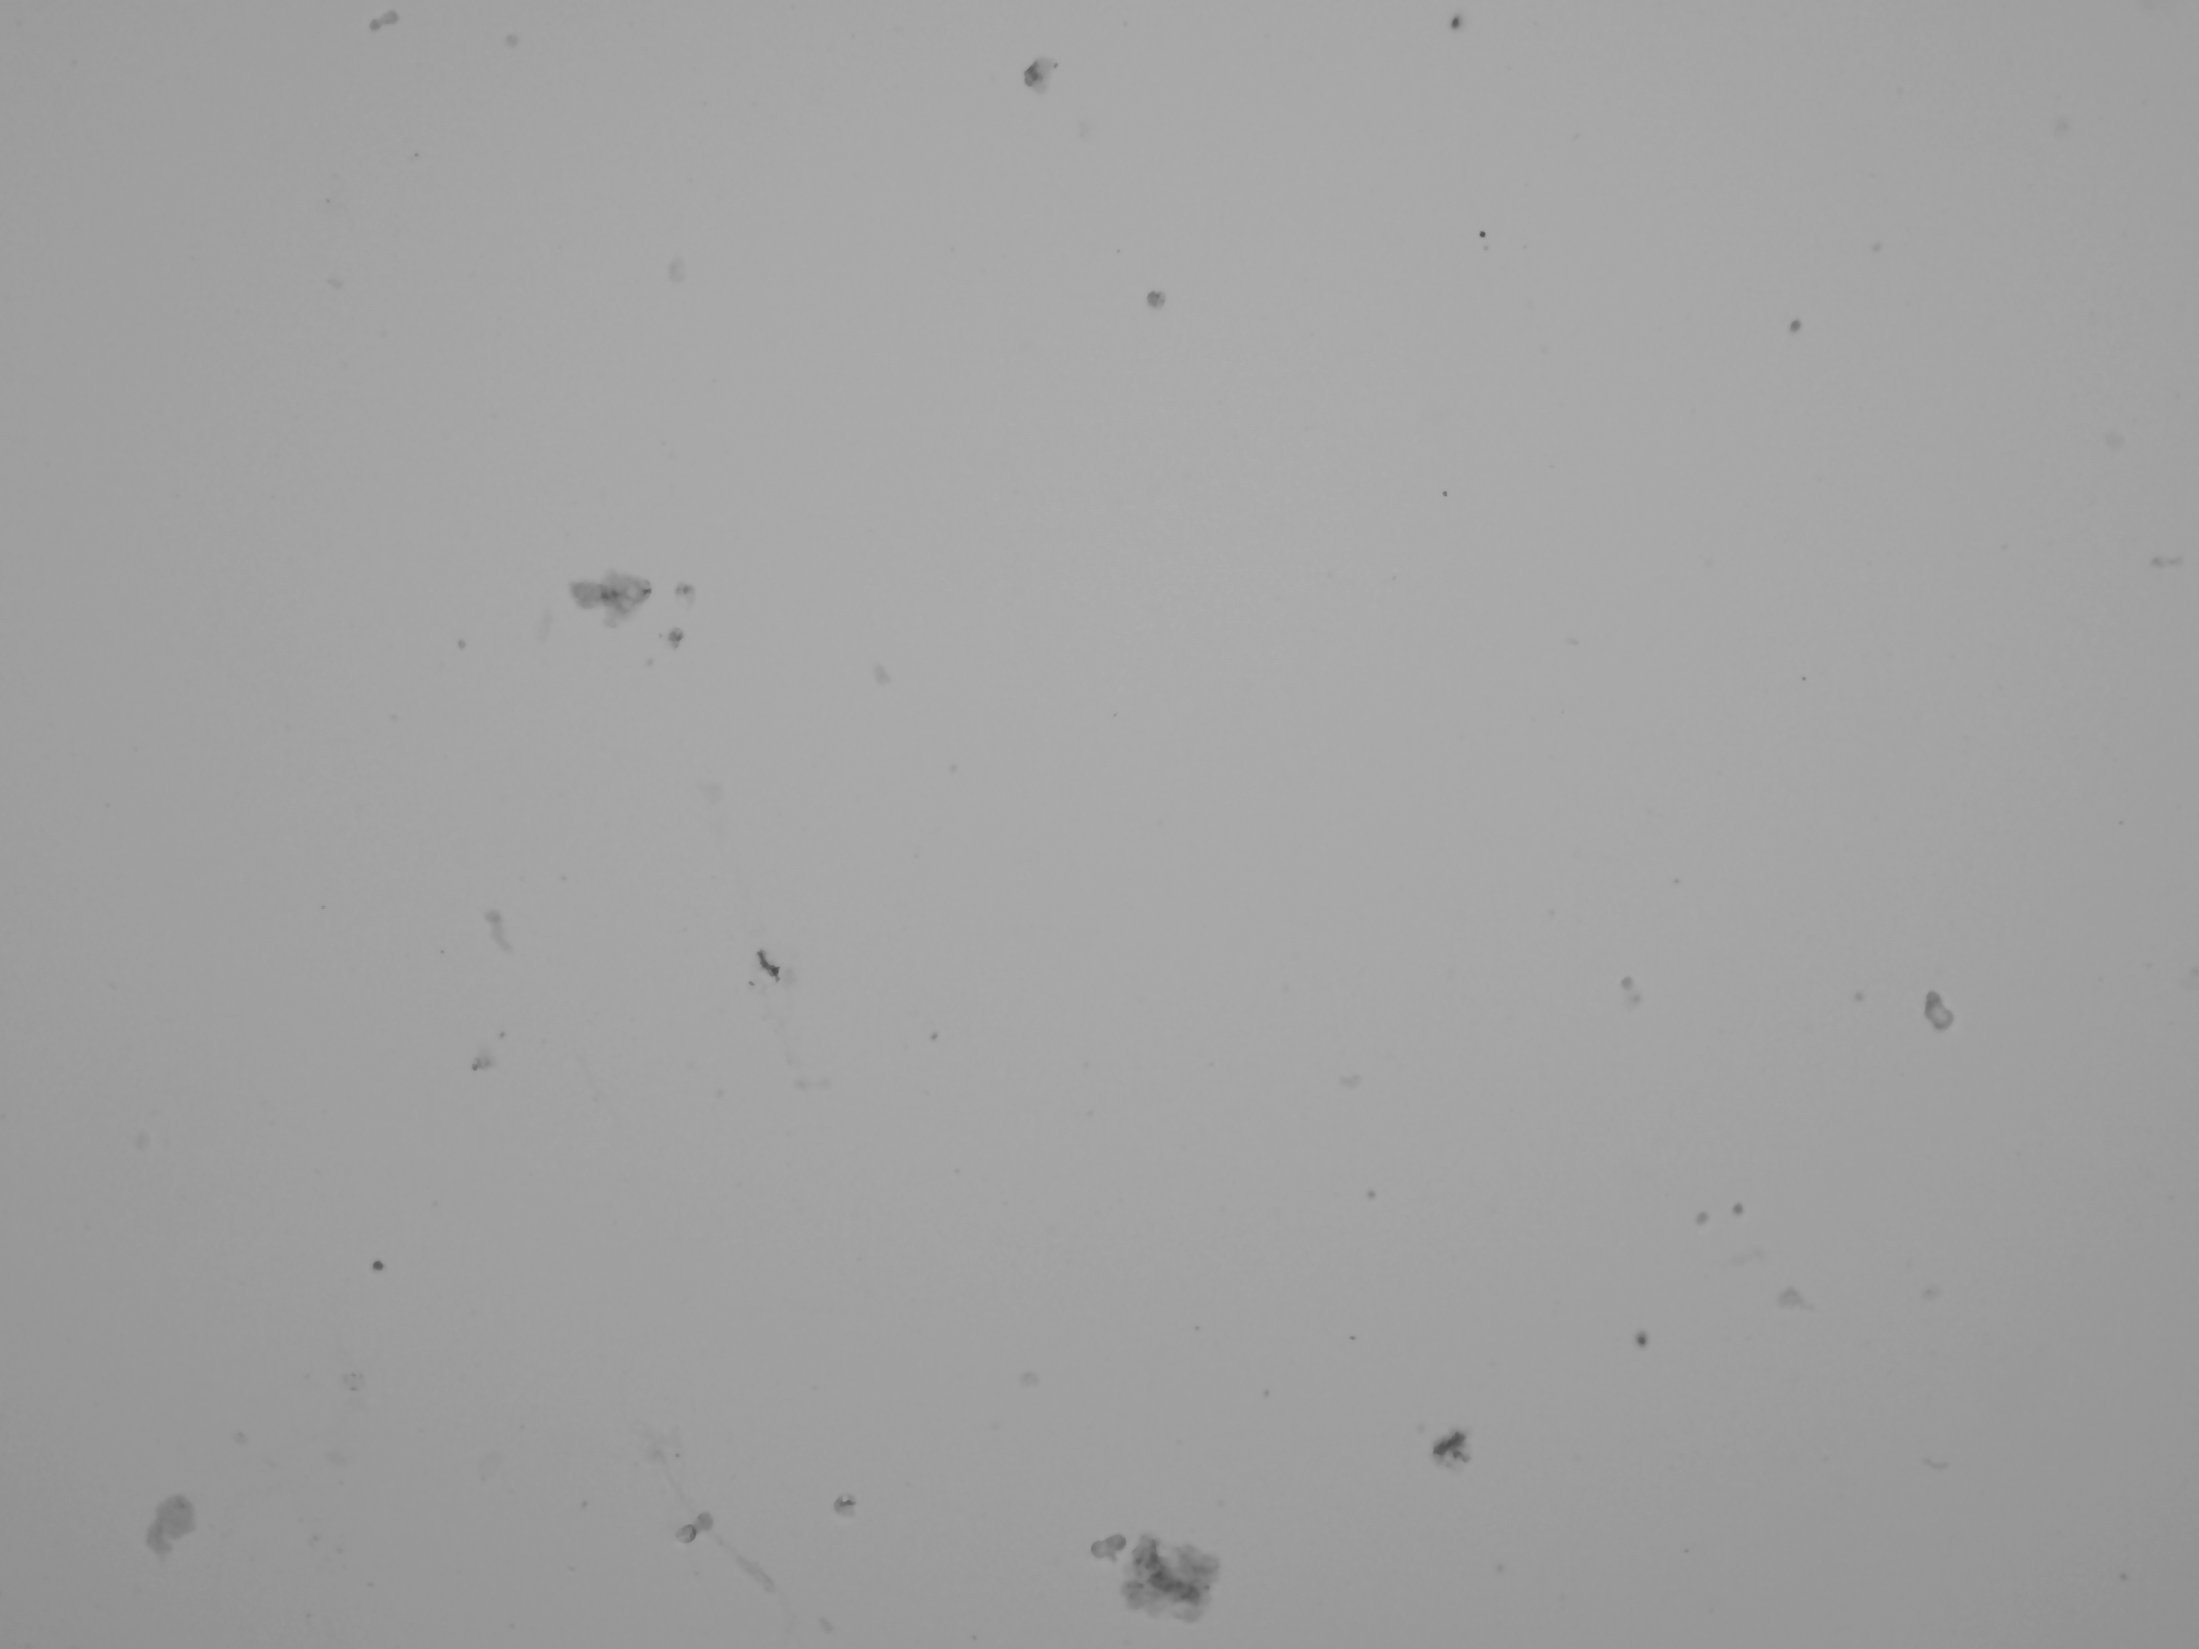
Summary - debris
Work on gentle dissociation cells.
Ex) Trituration with P-1000 first then P-200.
Filtration (ex, 40 micron strainer).
Density gradient centrifugation.
Ex) ficoll or sucrose gradient.
Detergents.
Redo cell isolation.
Debris
Debris

Slide 12
Doublets
Non-single cell clumps.
Integrated into droplets and cannot* distinguish from single cells.
Doublet
Bad for any single cell experiment.
*Call some doublets in tagged cells (multi-seq or ‘Feature Barcodes’)

Slide 13
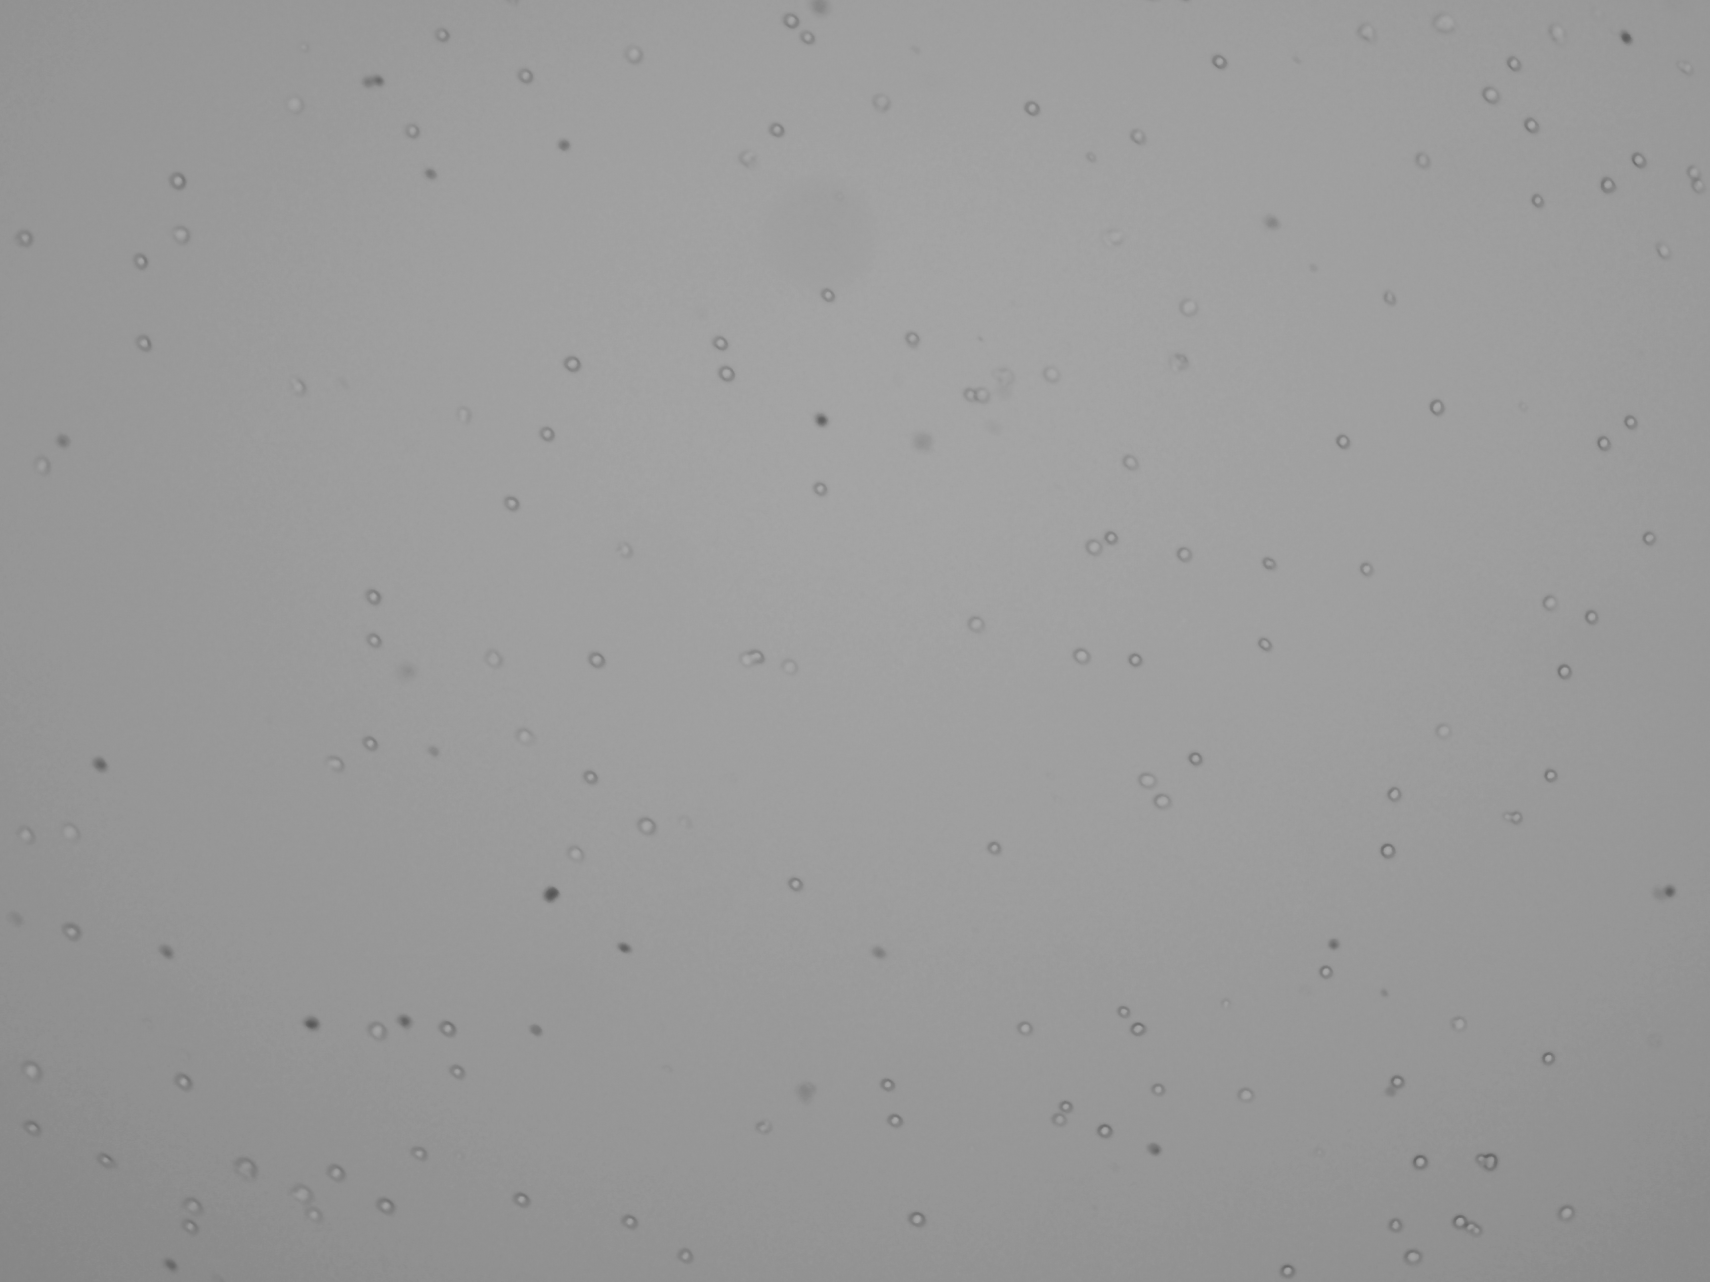

Doublets example I
Doublet
Clump
Good sample Many multiplets

Slide 14
Summary - doublets
Did you fully dissociate your tissue?
Cells can sit too long → clumps.
Depends on cell type.
Know the temperature your cells are happy at.
Ex) some bovine cells like to be warm; neurons RT, etc.
Add blocking agent.
BSA or FBS (make sure conc. compatible with 10X)

Slide 15
Dead cells
Single cell suspension
Live / dead staining
Redo isolation or dead cell removal
NO
Are my cells live?
YES
Count

Slide 16

Assessing cell death
Dead
Dead
Use cell-impermeant dye or fluorescent labels.
Automated cell counter okay, but sometimes better by hand.
Very small cells may stain ‘dead’ automated cell counter.
Cells die during isolation, but also during (improper) cryopreservation.
Count before and after cryopreservation.

Slide 17
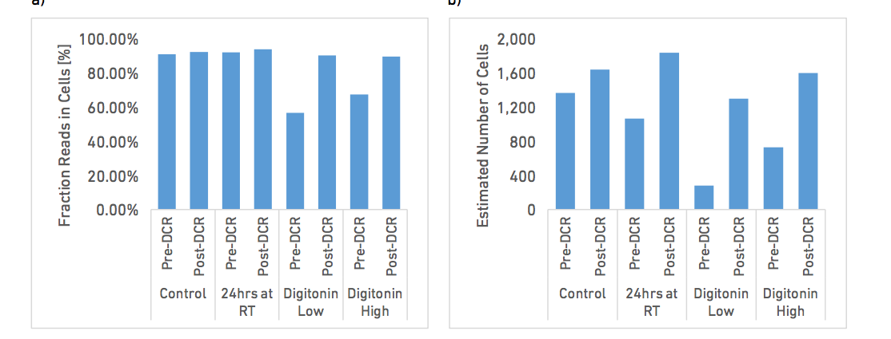
Do I need a clean suspension?
Digitonin (mimics dead cells) treated cell suspension.
DCR – Dead Cell Removal
Recovery (cells)
% Reads in cells
Reads in cells.
Targeted recovery.
CG000130_10x_Technical Note_DeadCell Removal_RevA.docx

Slide 18

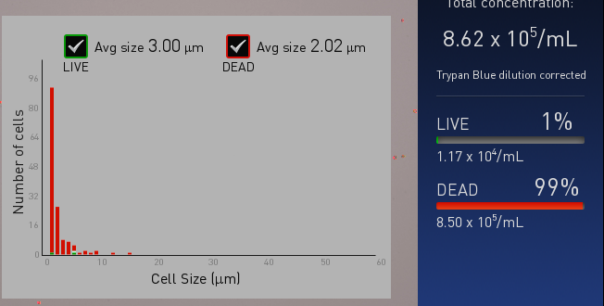
Cell Size and did I isolate the correct cells?
Microfluidics have cell size limit
40 microns or less.
Clogs, etc.
Nuclei isolation great alternative to large cells.
Know your cell size.
Do you have RBC contamination (‘empty’ cells).
Small dark cells
Histogram cell size

Slide 19


Cell size – example I
Expect cells to be from 2 micron to 20 micron.
Average size 3um.
Tiny cell
Two different isolations from same tissue.
Left – small and uniform.
Right – variable sizes.

Slide 20
Overview
Technology overview.
Single cell isolation.
Sample QC.
Do I have single cells?
Are they alive?
Are they too big?
Did I isolate the correct cells?
How do I count them?
Methanol Fixation.

Slide 21
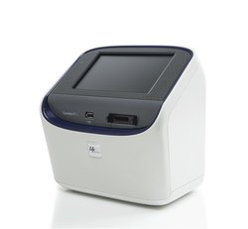
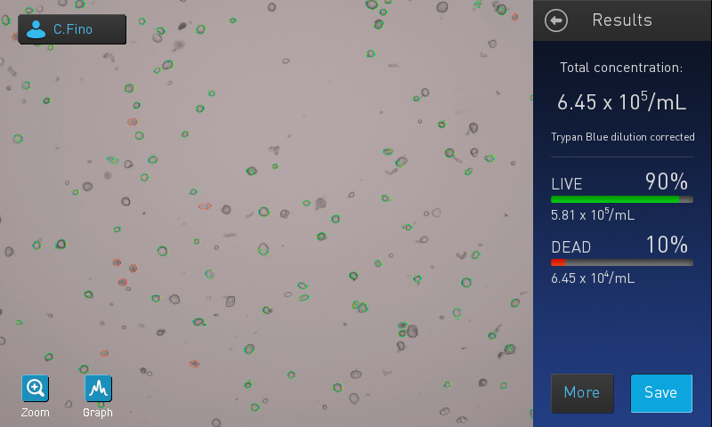
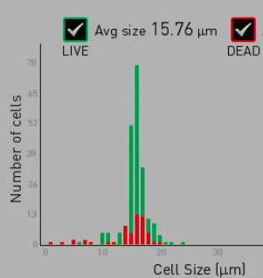
Cell counting – automated
Countess II (done by DNA Tech).
Pros (+):
Fast.
Live/dead cell counts.
Cell size estimates.
Cons (-):
Cell size limits (4-60um).
Performance poor for odd shapes.
Cell type limitations (DRG…)

Slide 22
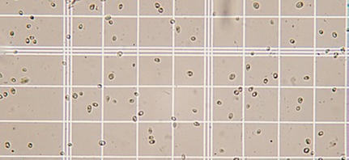
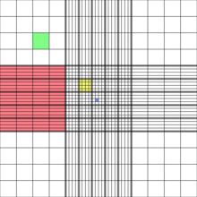
Cell counting – manual
Hemocytometer (customer-supplied counts).
http://www.wetnewf.org/pdfs/hemocytometer.html
Pros (+):
Reliable cell counts.
Cons (-):
Slow?

Slide 23
Cell counting – automated
Flow
https://www.idexx.com
Pros (+):
Sort based on characteristics (fluorescence, etc).
Characterize cells.
Cons (-):
Cannot provide absolute counts.
Tends to overestimate cells.
Concentrate after.

Slide 24
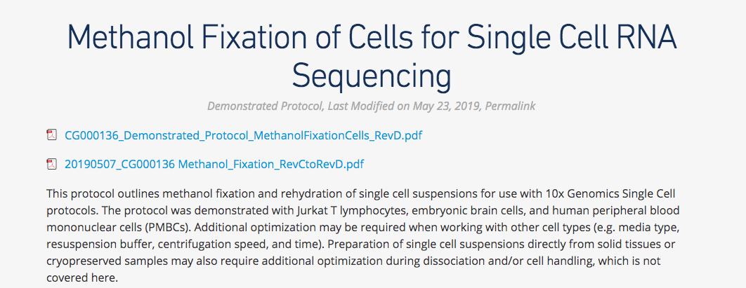
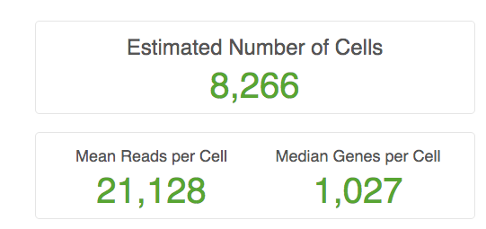

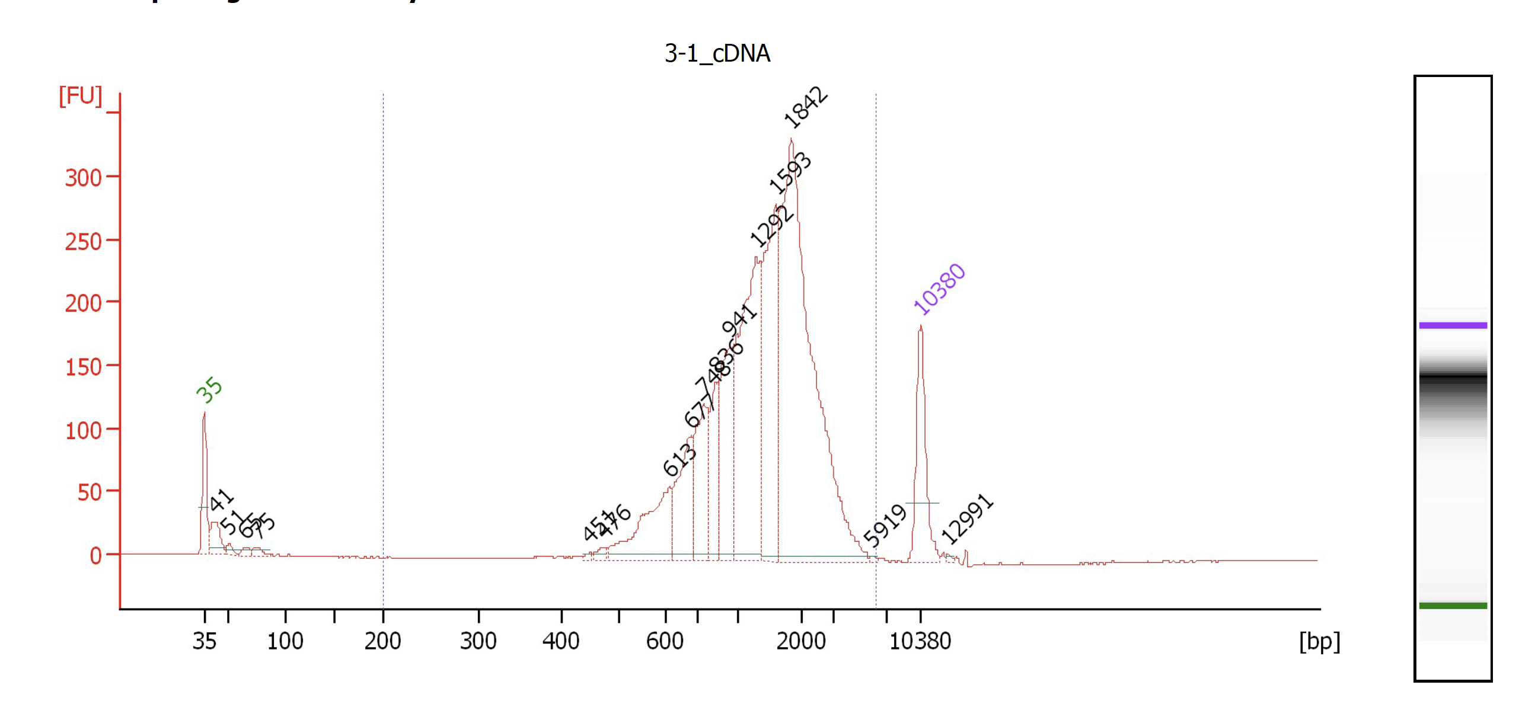
Methanol fixation
Methanol permeabilises cells and dehydrates proteins.
Kills infectious agents, while maintaining cell structure.
Cells stain 100% dead and can be stored for weeks

Slide 25
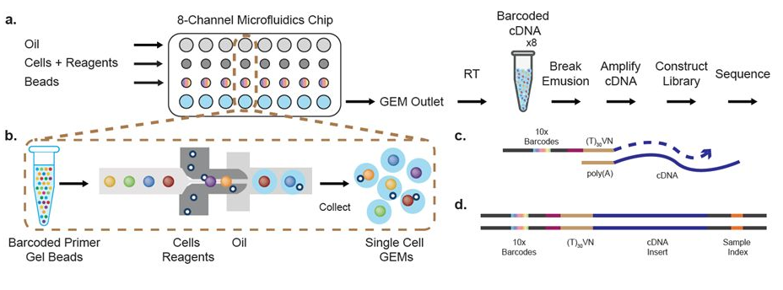
Important metrics – 10X
Concentration: 100-2,000 cells per µl.
700-1,200 cells per µl.
Count in replicates!
We require cell counts prior to delivery.
Viability: 70% minimum.
Nuclei and methanol fixed cells.
Sample buffer.
Cell size and shape..
Treat cells gently.
Wide bore pipette tips, keep cells on ice, etc.
Credit-10X Genomics

Slide 26
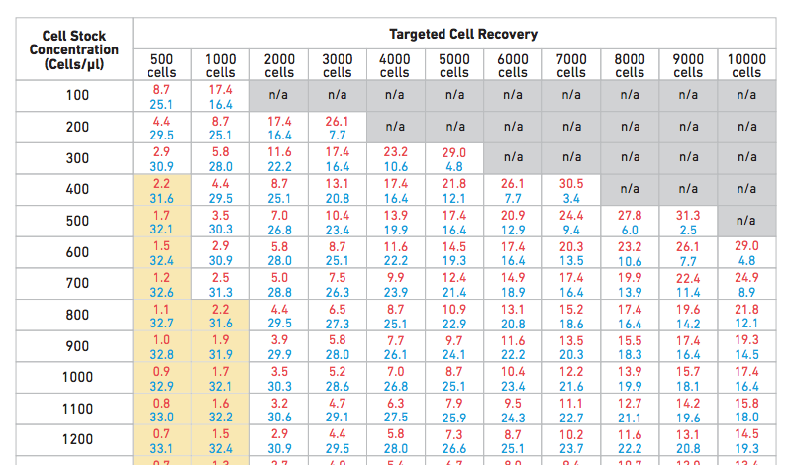
Chip loading
Very flexible → cell concentration and recovery.

Slide 27
Cost – 2019 10X Single Cell
UC RATES
Library prep | Total Cost
1 sample | $2,072
2 samples | $3,909
3 samples | $5,746
Per prep day | Cost
Labor, cell QC, chip | $235
Labor, reagents, instrument use | $1,837

Slide 28
Important resources
10X Genomics
https://support.10xgenomics.com/single-cell-gene-expression
UC Davis Flow Cytometry
http://www.ucdmc.ucdavis.edu/pathology/research/research_labs/flow_cytometry/index.html
Bridget McLaughlin (Technical Director)
UC Davis DNA Technology Core
http://dnatech.genomecenter.ucdavis.edu/single-cell-analyses/

Slide 29
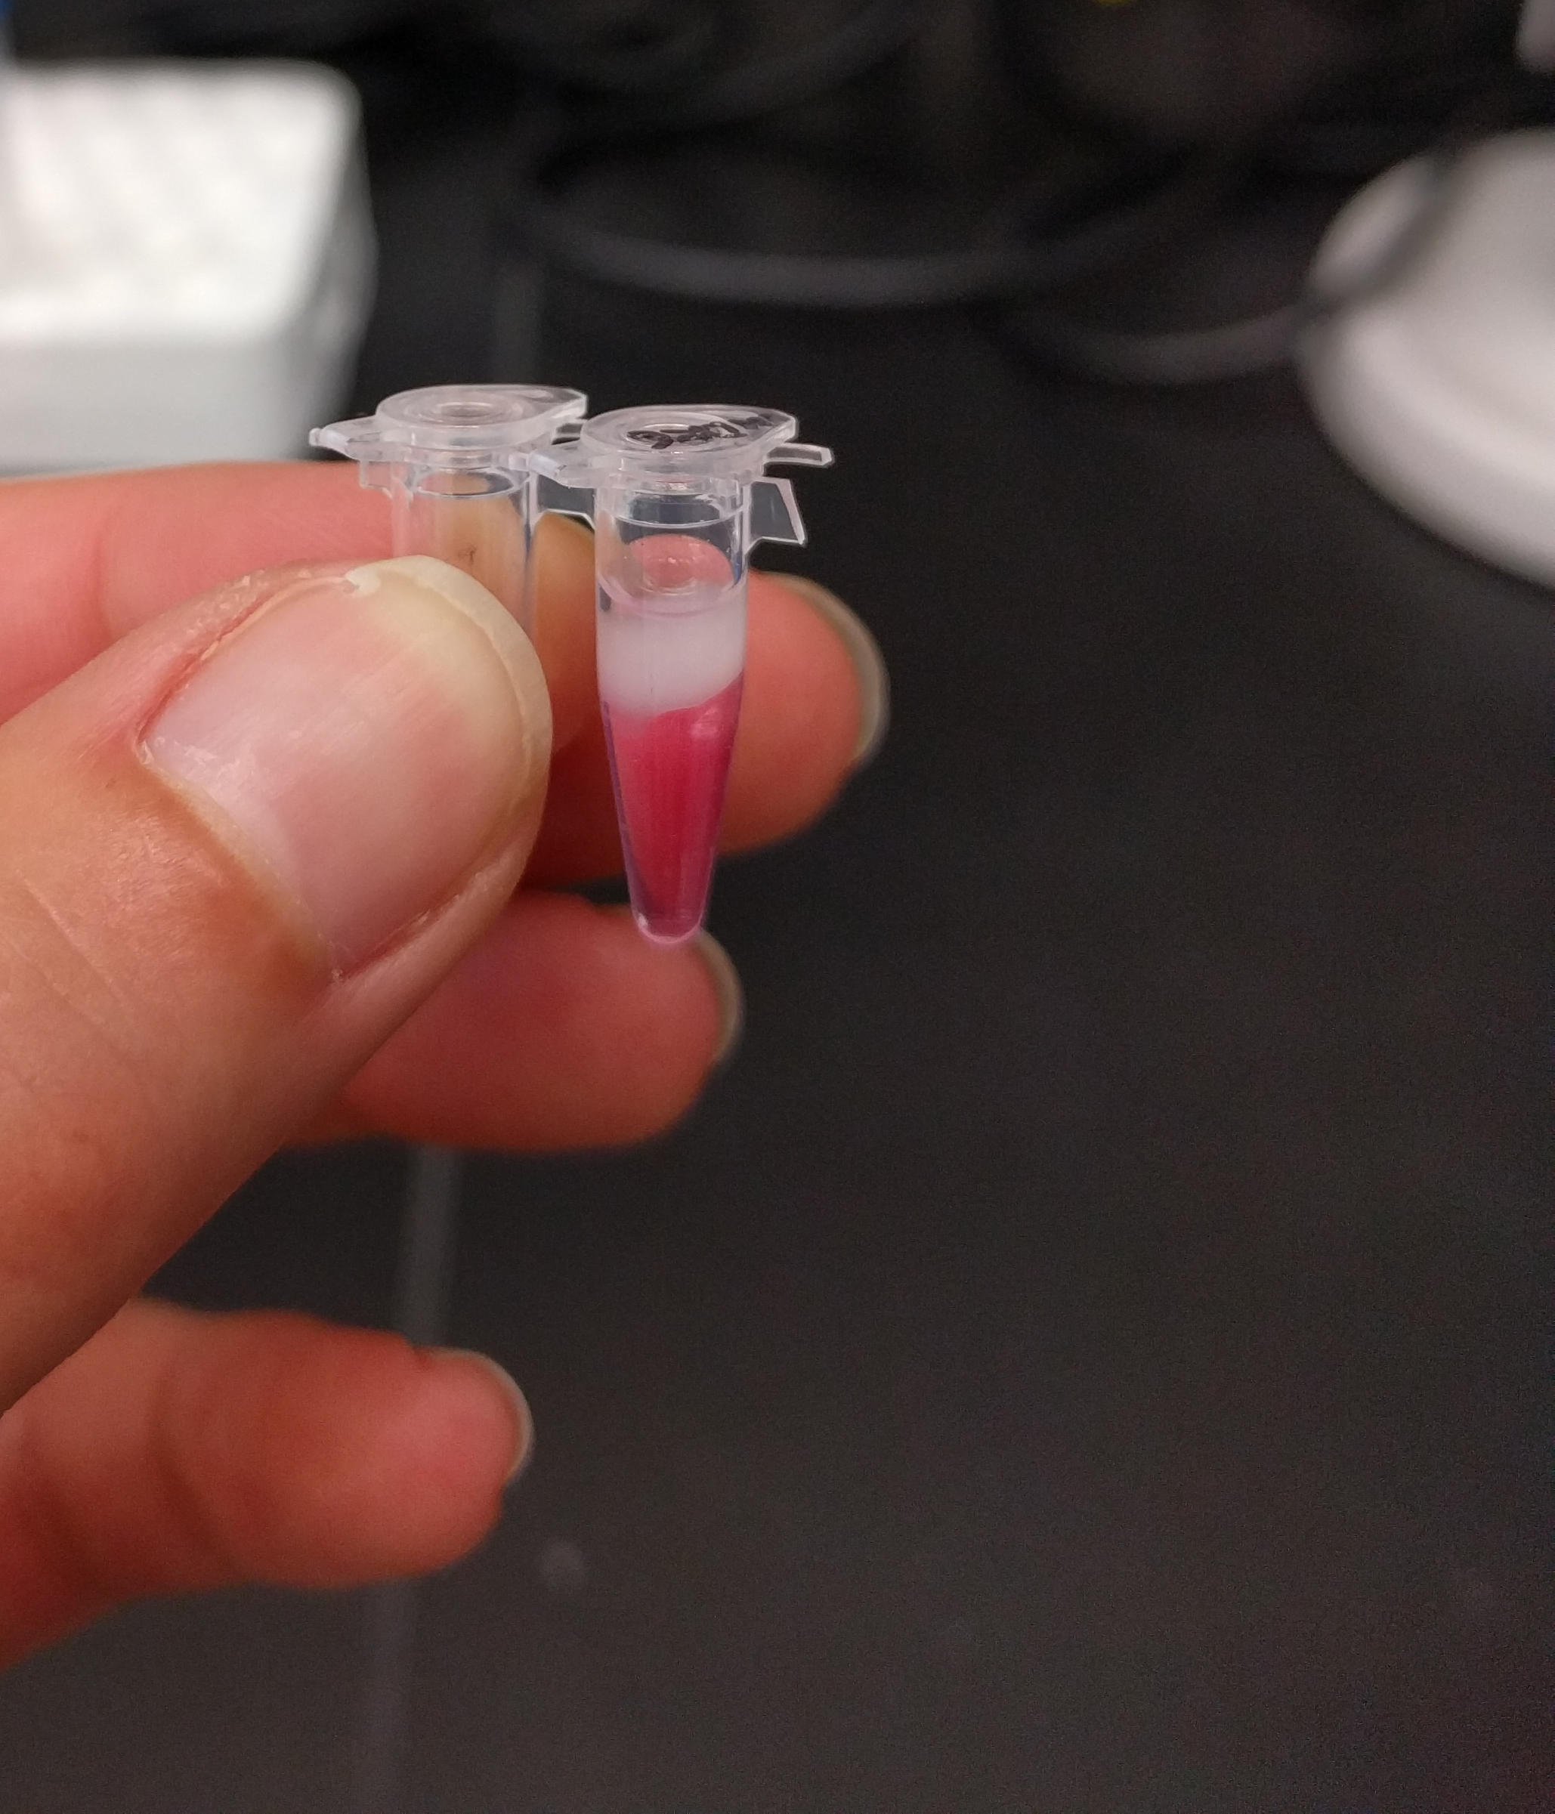
Acknowledgements
UC Davis DNA Technology Core.
UC Davis Bioinformatics Core.
10X Genomics.
Nicole Rapicavoli (Lead Field Applications Scientist).

